Slide 1
ROVER challenge team 1

Slide 2
Functionality
Reads shape file
Finds and displays the shortest path from A to B

Slide 3
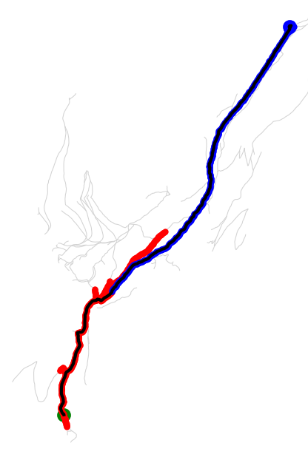
The result

Slide 4
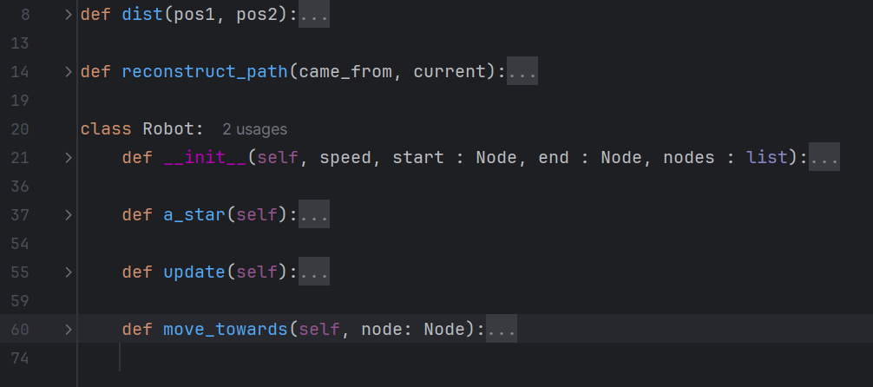
Robot structure

Slide 5
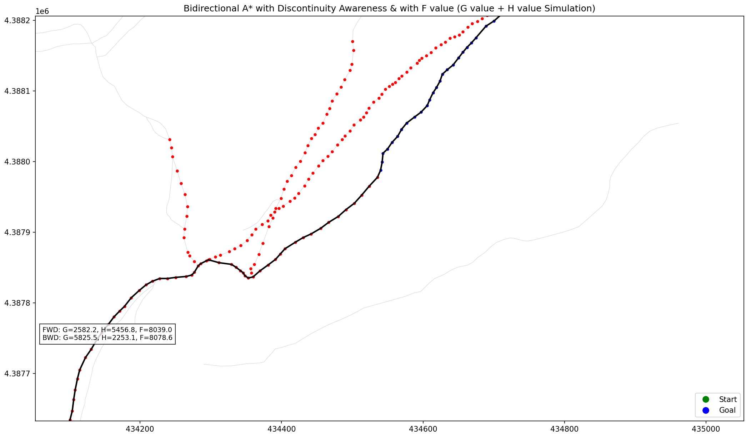
Selecting Visual Aids
The result
Shortest path is found when two paths meet

Slide 6
Challenges
Learning about shape files and A* algorithm
Handling intersections and discontinuity

Slide 7
Outcomes
In combination with our automatic path detection from LiDAR in Path 1, we can use this software to find, and help injured firefighters or find lost campers

Slide 8
